Slide 1

Final research discussion of the summer session!
August 14th, 2020

Slide 2
Agenda
Discussions on:
“Liver Cancer Stem Cell Markers: Progression and Therapeutic Implications”, led by Raichel Philip
“Promoting Positive Affect through Smartphone Photography”, led by Mayumi Gurung
Resources:
Research Position Database, exclusive to Hunter students who may be seeking internships in Hunter and other NYC laboratories from nearby institutions.
Website
Updates:
Fall semester + Google Form for students interested in presenting in the Fall

Slide 3
Liver cancer stem cell markers: Progression and therapeutic implications
Presented by Raichel Philip

Slide 4
Key Terms
Cancer recurrence: when cancer is found after treatment, and after a period of time when the cancer couldn't be detected.
Cancer stem cells (CSCs): cancer cells with stem cell features that are responsible for tumor relapse, metastasis, and chemoresistance.
We will be discussing CSCs for liver cancer
Targeted therapy: A type of treatment that uses drugs or other substances to identify and attack specific types of cancer cells with less harm to normal cells

Slide 5
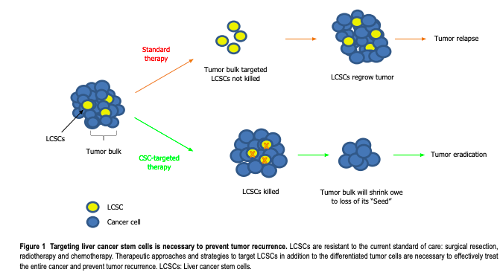
Main Topics
CSC involvement in liver cancer pathogenesis
Highly resistant cancer stem cells in liver cells have been proposed as responsible for tumor growth, invasion, metastasis and recurrence.
CSCs as preferential targets for therapy
We will discuss the markers used to define human liver cancer stem cells, the therapeutic implications of the expression of these markers in patient’s tumors, and the potential of the markers to be therapeutic targets.

Slide 6
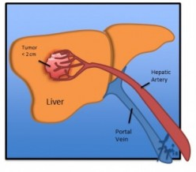
Introduction
Hepatocellular carcinoma (HCC) is the third leading cause of cancer-related mortality worldwide
High rate of recurrence(70%) following conventional treatments
Research has shown that liver cancers are derived from liver stem cells present in adult liver tissue
It has been proposed that HCCs display a large degree of heterogeneity
Distinct tumor cell populations express different markers
Liver CSCs are considered responsible for tumor growth, metastasis and recurrence of HCC and for the failure of chemotherapy and radiotherapy

Slide 7
Prevention of Tumor Recurrence in Liver Cancer Stem Cells (CSCs)

Slide 8
Introduction
A challenge in CSC research: the identification of CSC-specific marker sets and targeted therapeutic destruction are frequently debated topics
To improve prevention and treatment of CSCs
CSC markers must be clearly defined for each tissue
Cellular and signaling functions must be clarified to conduct better identification and diagnosis based on CSC biomarkers
These markers are necessary to isolate CSCs and analyze their biological characteristics to effectively target them

Slide 9
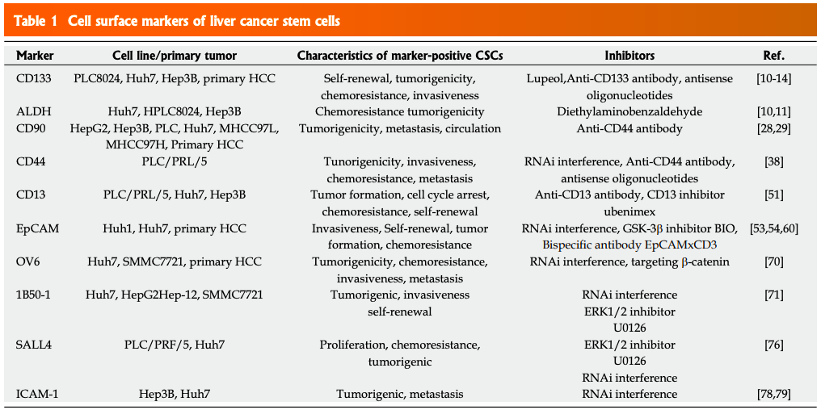
Cell Surface Markers of Liver CSCs

Slide 10
Cell Surface Markers of Liver CSCs

Slide 11
Liver CSC Markers as Therapeutic Targets
Antibody therapies against tumor cell surface antigens have improved clinical outcomes through inhibition of specific signaling pathways or enhanced activation of immune response.
Treatment of CD133+ HCC cells with an AKT1 inhibitor, which is specific to the Akt/PKB pathway, significantly reduces the expression of survival proteins.
Administration of anti-human CD44 antibodies in immunodeficient mice, formed by the intrahepatic inoculation of CD90+ liver CSCs, suppresses tumor nodule formation of liver tissue and metastatic lesions in lung tissue. And, the administration of CD44 antibodies has induced apoptosis in both CD90+ and CD90- cells in vitro
In CD13+ liver CSCs, the combination of a CD13 inhibitor and 5-FU(a medication used to treat cancer) greatly reduces tumor size compared to either agent alone

Slide 12
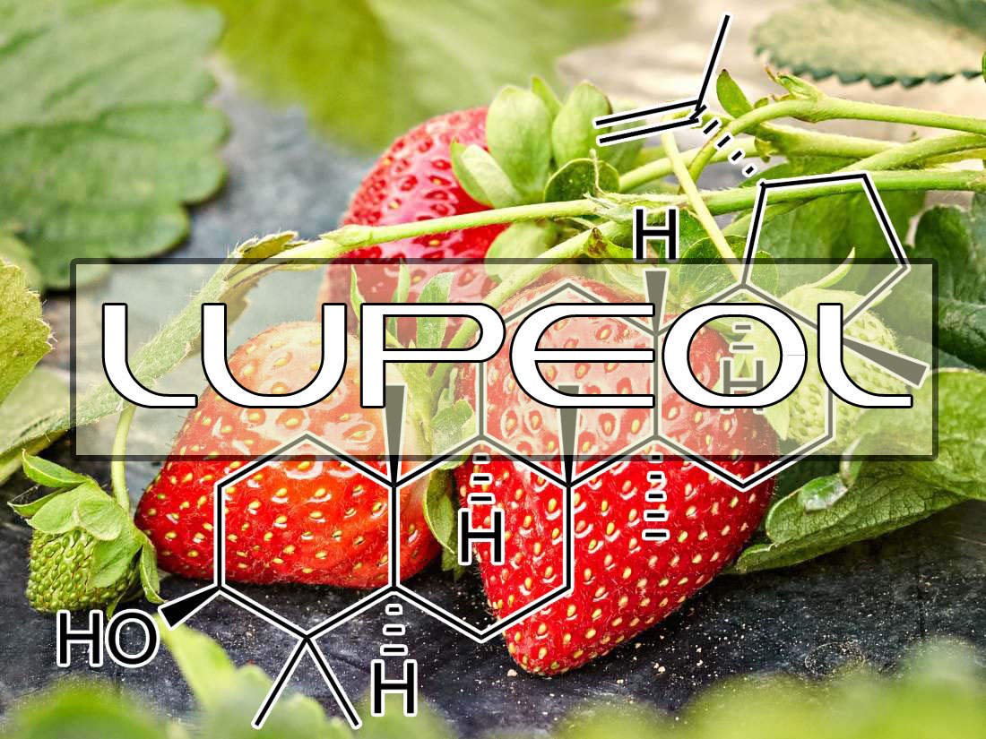
Liver CSC Markers as Therapeutic Targets
Lupeol
a phytochemical present in fruits and vegetables
Could target CD133+ liver CSCs by inhibiting their self renewal and tumorigenic capacity
Can also sensitize HCC cells to chemotherapeutic agents (doxorubicin and cisplatin) via the PTENAKT-ABCG2 signaling pathway.

Slide 13
Conclusion
There has research of markers that identify liver CSCs, leading to important developments in cancer treatment.
Important issues still need to be resolved:
Some markers that are significant to CSCs are also shared by normal stem cells → drugs targeting these markers could negatively affect normal stem cells
Molecular differences between CSCs and normal stem cells need to be specified
Need to determine how different liver CSC markers relate to one another
In summary: There needs to be more effective liver CSC markers identified in order to design more specific therapies against them. Specifically targeting CSCs is an improvement to the existing therapies and leads to long-term clinical benefits.

Slide 14
Citation
Sun, J. H., Luo, Q., Liu, L. L., & Song, G. B. (2016). Liver cancer stem cell markers: Progression and therapeutic implications. World Journal of Gastroenterology, 22(13), 3547.

Slide 15
Discussion Questions
Ethical issues in stem cell research
Human embryonic stem cell (hESC) research is ethically and politically controversial because it involves the destruction of human embryos.
Is hESC research an injustice to human life?
Not all stem cell research involves human embryos...
Induced Pluripotent Stem Cells (iPSCs) are stem cells derived from adult humans by the genetic reprogramming of somatic cells and are an alternative to hESCs.
If researchers are able to develop full embryonic potential in iPSCs, the cloning controversy is brought up, as the resulting cells would be genetic matches of their human donors. What are your thoughts?

Slide 16
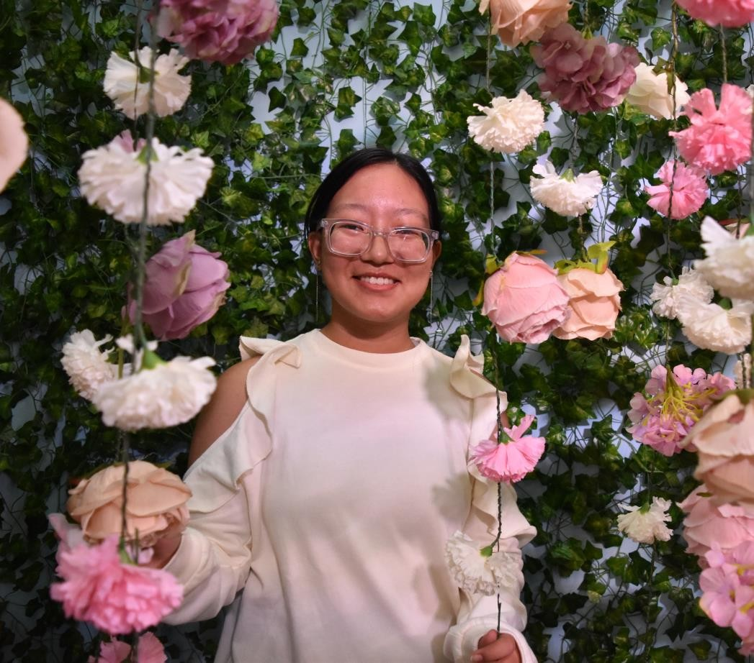
PROMOTING POSITIVE AFFECT THROUGH SMARTPHONE PHOTOGRAPHY:
PRESENTED BY MAYUMI GURUNG
Sm M O T I N G P O S I T I V E
A F F E C T
T H R O U G H
P H O N E

Slide 17
The Basis
Positive psychology
Smartphones
College Students

Slide 18
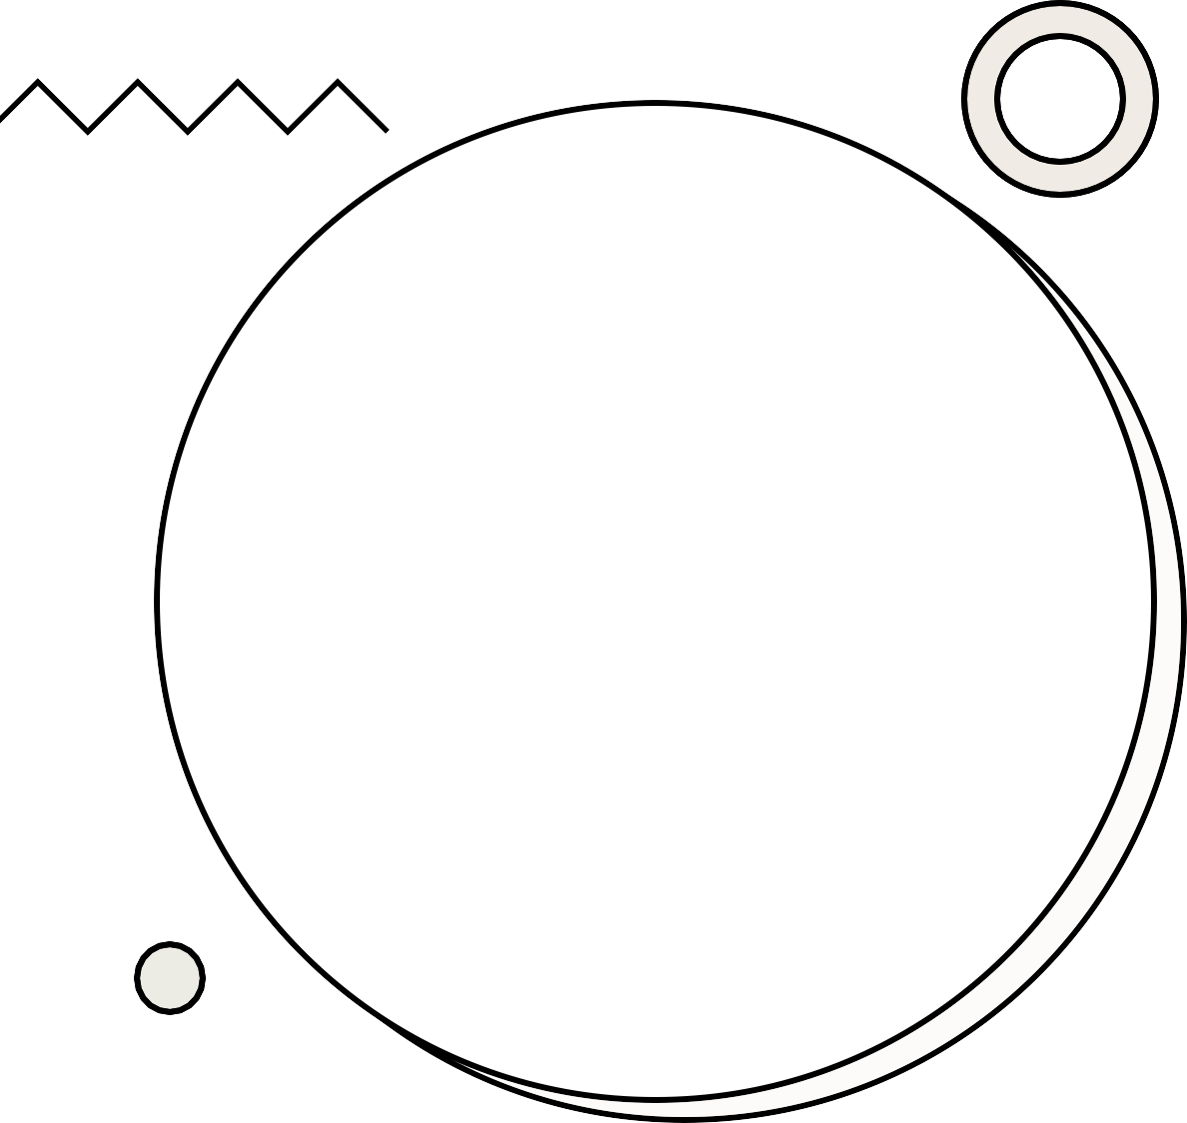
"Positive Psychology is the scientific study of the strengths that enable individuals and communities to thrive. The field is founded on the belief that people want to lead meaningful and fulfilling lives, to cultivate what is best within themselves, and to enhance their experiences of love, work, and play."
-Positive Psychology Center at the University of Pennsylvania
What is Positive Psychology?

Slide 19

Popular
Why smartphone photography?
Easy measurement tool
Never studied before

Slide 20

T H E
P A R T I C I P A N T S

Slide 21

Experimental Groups
SELFIE: KLEINKE ET AL. (1998)
PERSONAL: SELIGMAN ET AL. (2005)
OTHER: DUNN ET AL. (2008)
AND SEPPALA AND TOMASELLO (2013)

Slide 22
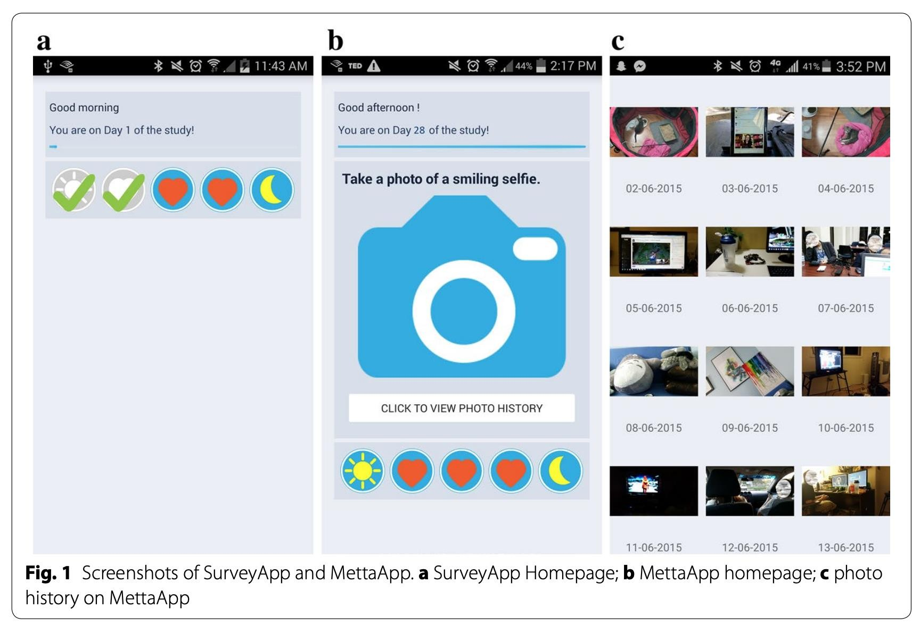
Methods

Slide 23
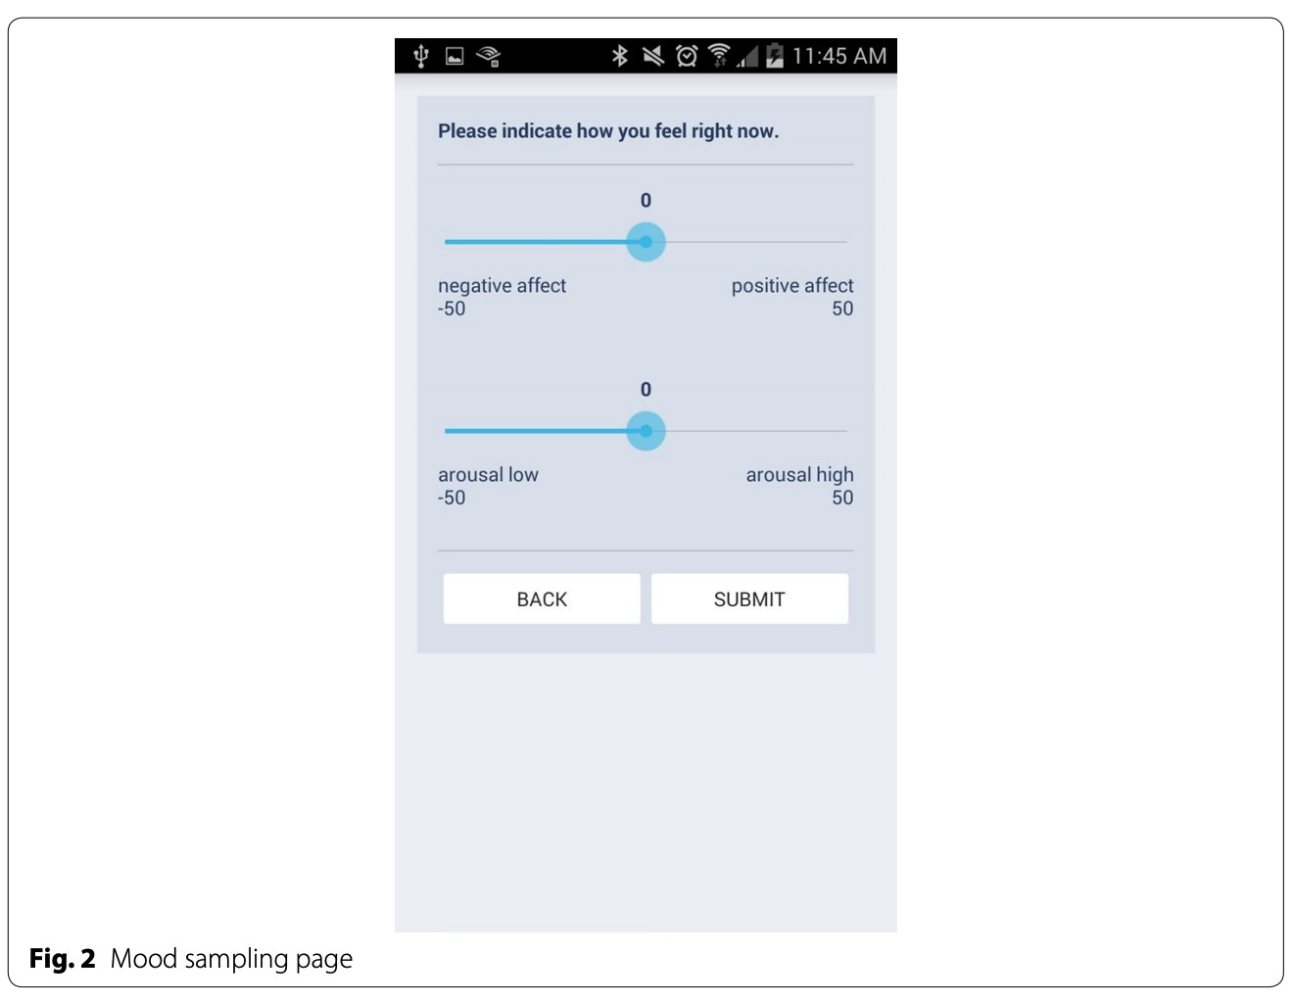
Methods

Slide 24
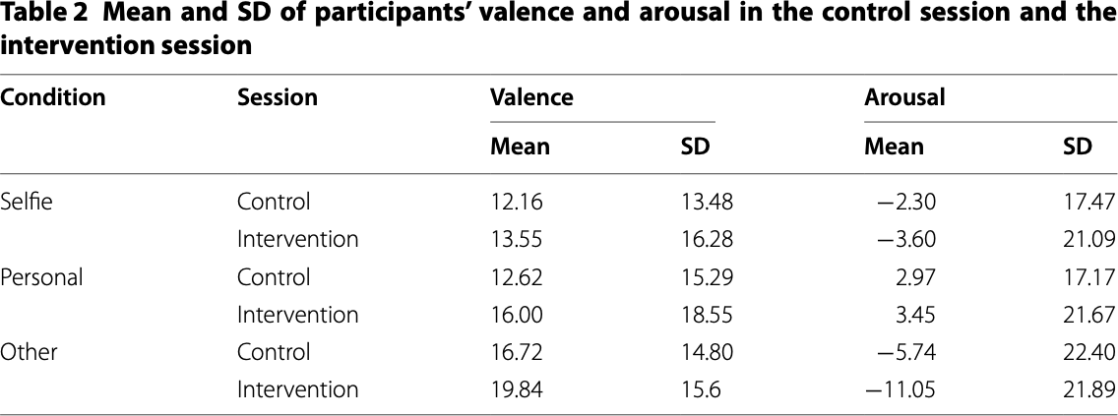
Results

Slide 25
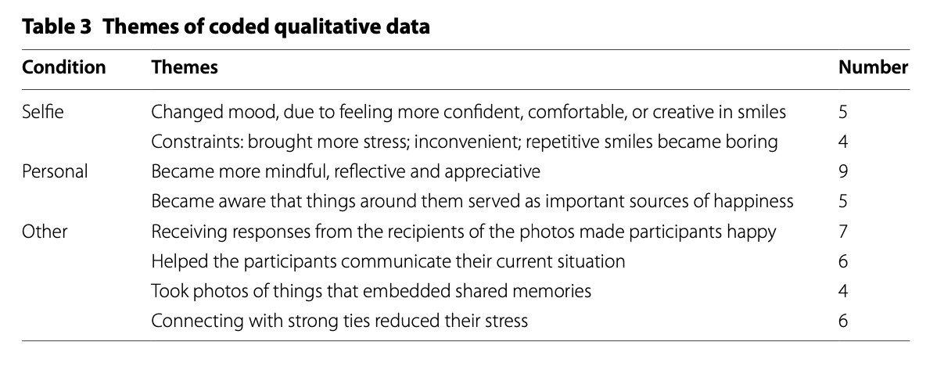
Results

Slide 26
Conclusion
Smartphone photography can be used to
improve mood and increase calmness
Question: How can we utilize this
information to our advantage?

Slide 27
How do they differ? Feel free to answer in either an objective or subjective manner.
Discussion: MettaApp vs Social Media

Slide 28
Citation
Chen, Yu, et al. “Promoting Positive Affect through Smartphone Photography.” Psychology of Well-Being, vol. 6, no. 1, Dec. 2016, p. 8. DOI.org (Crossref), doi:10.1186/s13612-016-0044-4.

Slide 29
Research Database/Website

Slide 30
Fall Semester:
Presentation Form
Deadline: September 1st
https://forms.gle/AugbTgCqBCv1VmUw7

